Slide 1
Data Structure and Algorithm CSE225
Dr. Mohammad Abu Yousuf
yousuf@juniv.edu

Slide 2
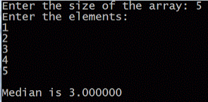
#include<stdio.h> #include<conio.h> int main() { clrscr(); int a[10],i,n; float m; printf("Enter the size of the array: "); scanf("%d",&n); printf("Enter the elements:\n"); for(i=0;i<n;i++) { scanf("%d",&a[i]); } if(n%2==0) { m=(a[n-1/2]+(a[n/2]))/2; } else { m=a[n/2]; } printf("\nMedian is %f",m); return 0; }
C program to find the median of n numbers

Slide 3
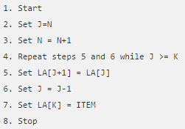
Insert an item into a linear array
Let LA is a Linear Array (unordered) with N elements and K is a positive integer such that K<=N.
Below is the algorithm where ITEM is inserted into the K^{th} position of LA −

Slide 4
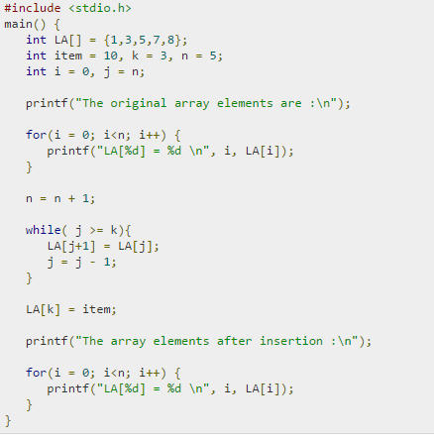
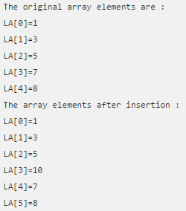
Insert an item into a linear array

Slide 5
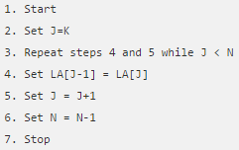
Delete an existing item from the array
Algorithm:
Consider LA is a linear array with N elements and K is a positive integer such that K<=N. Below is the algorithm to delete an element available at the K^{th} position of LA.

Slide 6
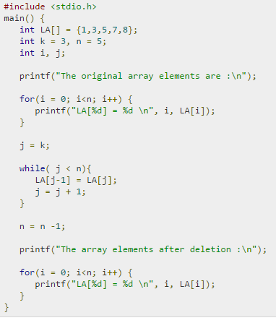
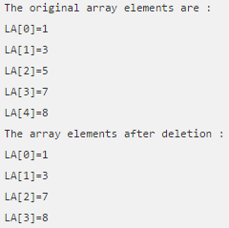
Delete an existing item from the array

Slide 7
Records or Structures
A structure is a collection of logically related variables under a single unit/name.
These variables can be of different types, and each has a name which is used to select it from the structure.
A structure is a convenient way of grouping several pieces of related information together.

Slide 8
How to declare a structure
Example: Syntax :
struct Rectangle
{ float Length;
float width;
float area;
};
Declaration of structure does not occupy space in memory. One has to create the variables for the struct and variable will take spaces in memory.
struct structure_name { data_type member1; data_type member2;
.
.
data_type memeber;
};

Slide 9
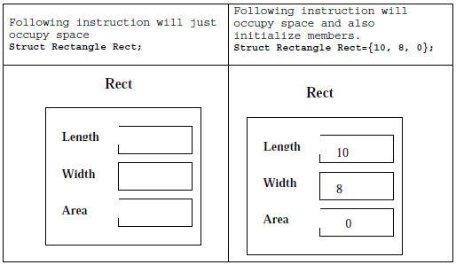
How to declare a structure
For example:

Slide 10
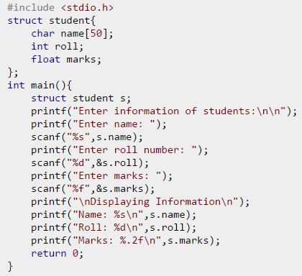
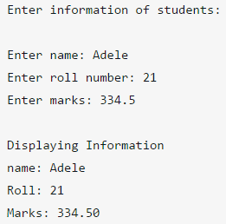
Example: C Program to Store Information of Students Using Structure

Slide 11
Representation of Records in memory: Parallel Array
parallel arrays is a data structure for representing arrays of records.
It keeps a separate, homogeneous data array for each field of the record, each having the same number of elements.
For example:
struct Rectangle
{ int studID;
char name[20];
char major[10];
int level;
};

Slide 12
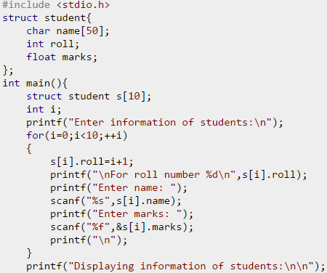
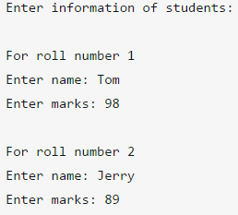
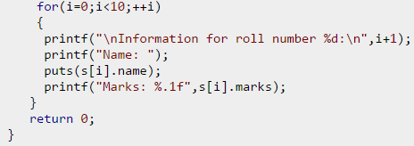
Array of Structure

Slide 13
Thank you

